Slide 1
‘Zero emission heavy-duty waste collection vehicles.
Market gaps and collaboration to advance on innovation’

Slide 2
What is the Big Buyers?
Collaboration between big buyers in Europe in strategic public procurement to help drive the market for innovative and sustainable goods and services.
An initiative of the European Commission, DG Grow.
Managed by Eurocities and ICLEI

Slide 4
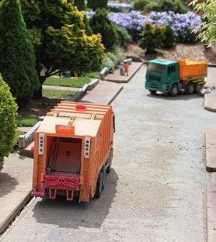
Heavy-Duty Electric Vehicles
Focus
Electrification of heavy-duty vehicles (waste trucks, street cleaning, heavy delivery)
Acquisition of new vehicles
Retrofitting of current vehicles
Buyers
Rotterdam, Amsterdam, Oslo, Cologne, Helsinki, Gothenburg, Lisbon, Porto, …
https://bigbuyers.eu/working-groups/electric-heavy-duty-vehicles

Slide 5
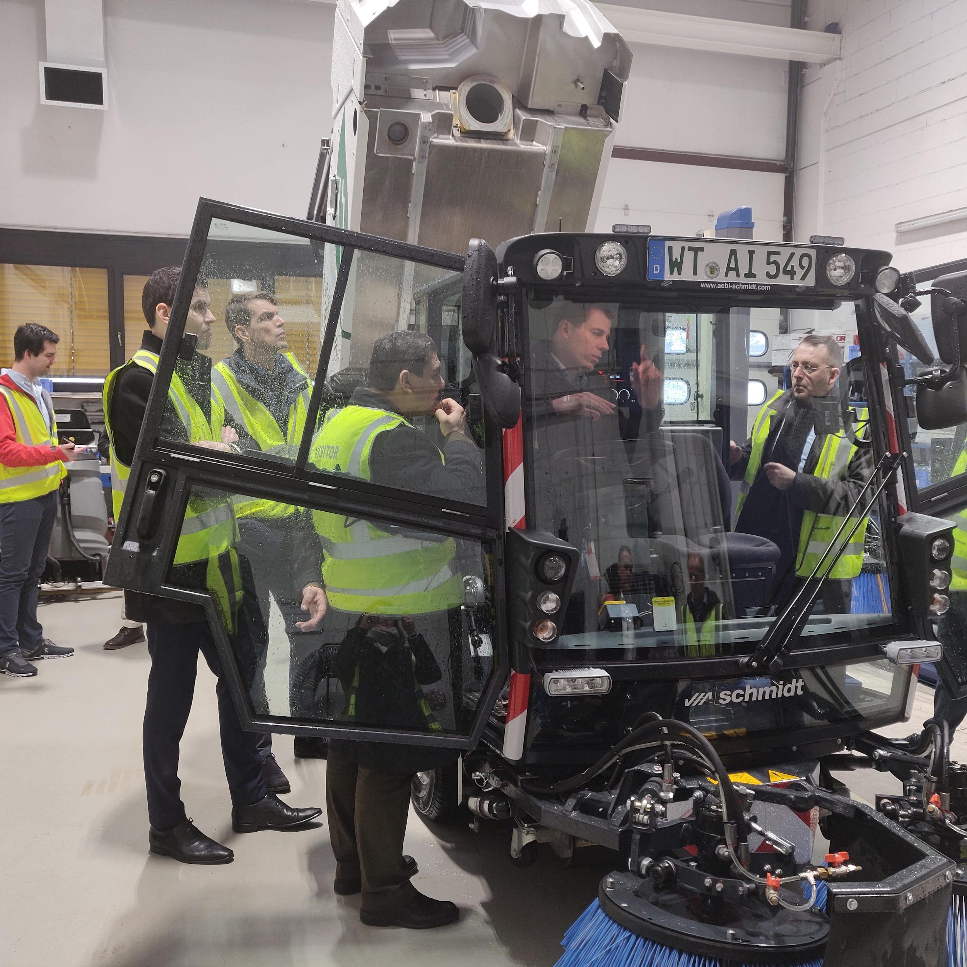
Heavy-Duty Electric Vehicles
Added value
Accelerating acquisition of electric vehicles, to achieve zero emissions vehicle fleets in cities by 2030
Support market options availability for EU peripheral regions
Support R&D efforts of suppliers by further understanding entities‘ current and future needs

Slide 6
Advantages of joint European collaboration
Participants
Higher purchasing power > work jointly on market consultations/market dialogues
Share information on new technologies, products availability and prices across Europe
Sharing on LCA methodologies, market engagement techniques and successful procurement criteria (i.e. how to evaluate and compare the environmental ambition of tender offers)
Companies
Support R&D efforts, by providing test grounds for pilots
Understanding upcoming procurement plans of buyers and their needs/challenges

Slide 7
Lesson learnt from the collaboration
Year 1
Year 2-3
Year 4-8?

Slide 8
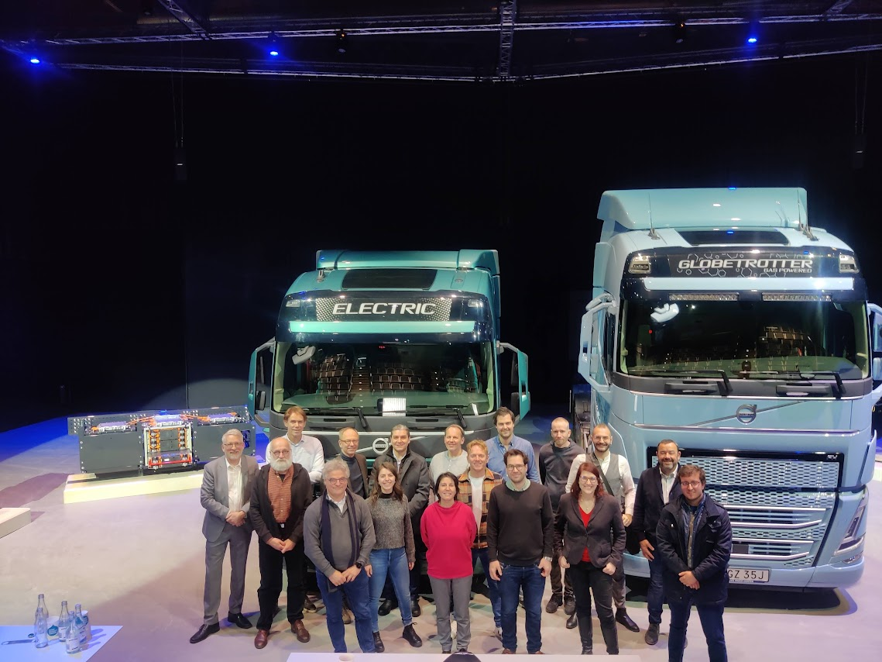
Lesson learnt from the collaboration
Successful market collaboration and country ‘relationship’
Piloting of solutions or the use of innovation procurement and mini competition

Slide 9
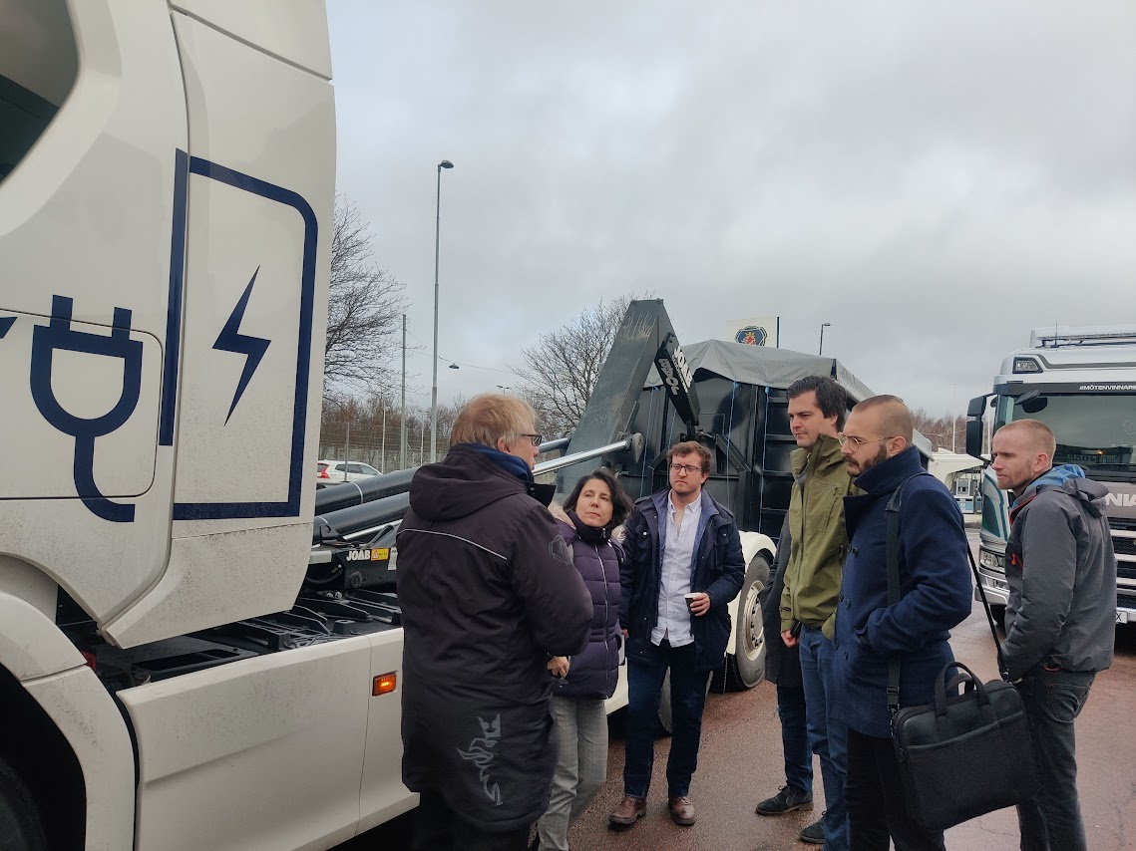
Lesson learnt from the collaboration
3. Data and batteries performance
4. Is all about people!

Slide 10
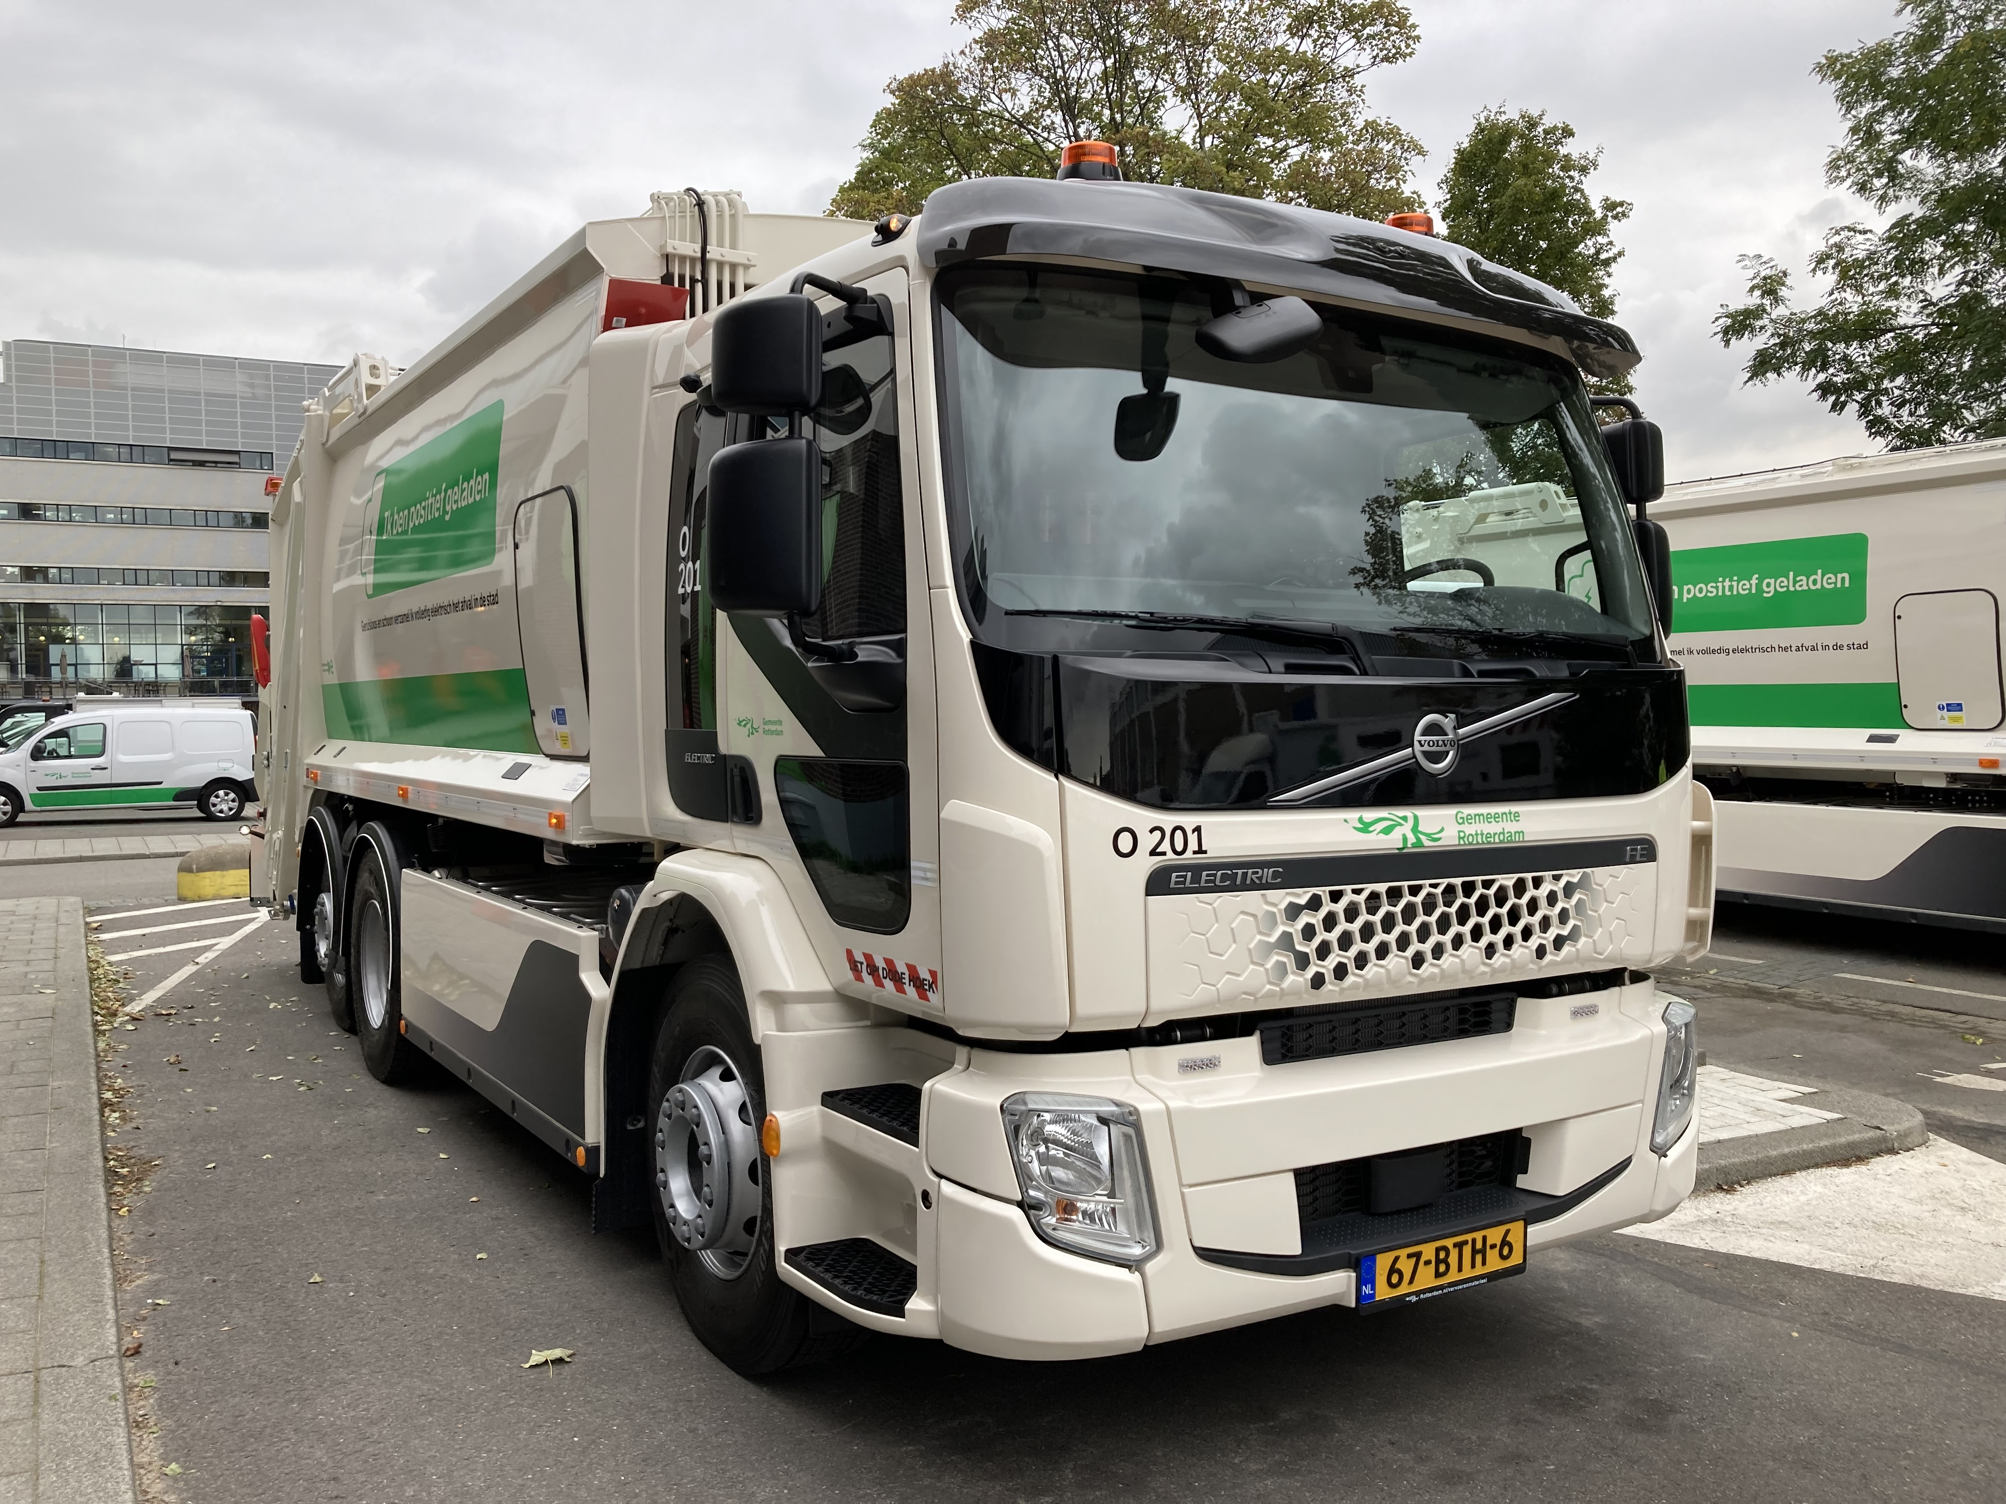
Learning from Rotterdam
Rotterdam has three suppliers for truck chassis (DAF, Volvo, MAN);
Mini competition 2020;
Volvo won this mini competition
One (1) garbage truck delivered in 2021
Two garbage trucks in 2022
Heavy duty vehicles are usually procured through European tenders using article 32 of the EU L 94/114, ‘Use of the negotiated procedure without prior publication’.
Notes:
Rotterdam has been using innovation procurement and mini competitions to purchase vehicles and test their performance in real life. This allowed them to acquire vehicles from different companies. They currently have three suppliers for truck chassis (DAF, Volvo, MAN).
The advantage of mini competitions are:
they don’t depend on one supplier;
their pricing is determined in the mini competition (current prices);
it gives the buyer the ability to purchase new products.

Slide 11
Joint statement of demand and market gaps

Slide 12
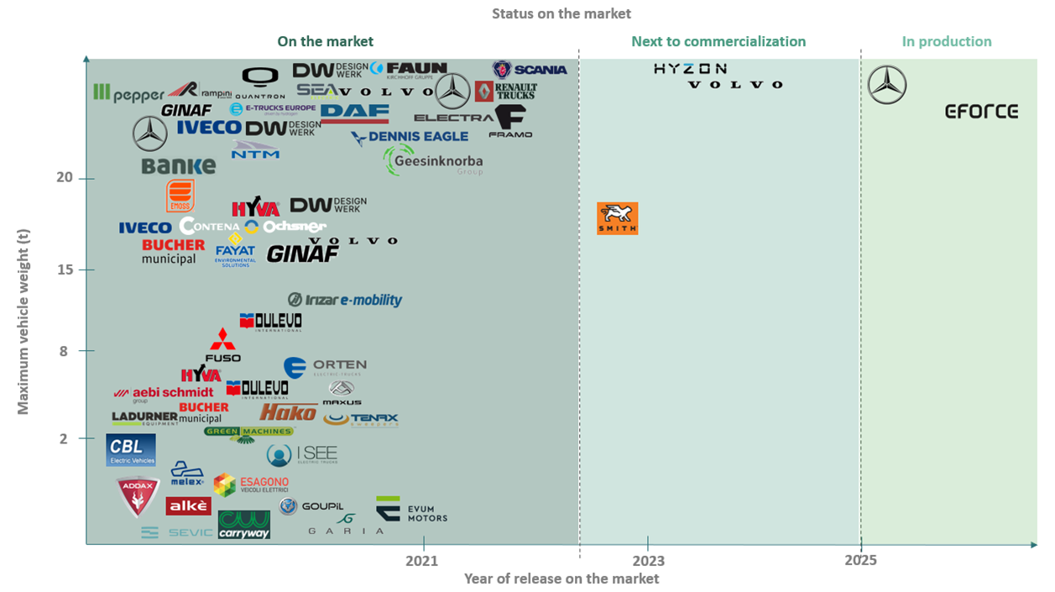
Collaboration with ENTRANCE project

Slide 13
Market gaps
The large gap in the Total Cost of Ownership compared to diesel equivalents, combined with the operational limitations such as range constraints, running time, or payload losses, are the main factors hindering the transition to Zero-Emission vehicles (ZEV).

Slide 14
Market gaps
1) Data and planning operation
2) Delivery time and issues in the supply chain
3) After-sale support and dismantling
4) Batteries
5) Energy production and recharging infrastructure

Slide 15
The elephant in the room
6) High-cost and high risk
Not enough financing to buy an entire fleet of new vehicles so there is also need for retrofitting as a mid-term solution (retrofit for 5-6 years) until it is possible to purchase the new vehicles

Slide 16
THANK YOU!

Slide 17
Thank you!
Anja De Cunto – Eurocities anja.decunto@eurocities.eu
Contact us:
info@bigbuyers.eu
www.bigbuyers.eu
The Big Buyers is a European Commission platform for promoting collaboration between big public buyers in implementing strategic public procurement for sustainable and innovative goods and services.

