Slide 1
HDEV – waste collection
Our experience – so far
Peter Årnes City of Gothenburg

Slide 2
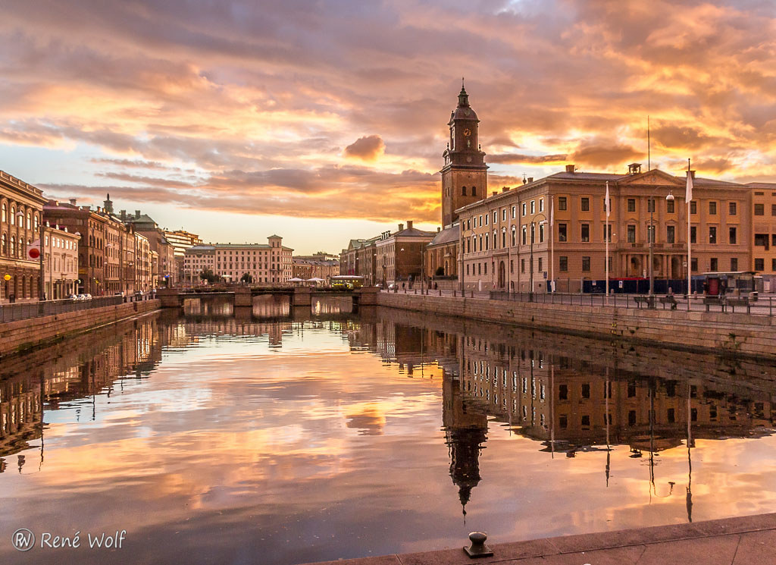
Sustainable waste and water
A department within the City of Gothenburg
The department of Sustainable Waste and Water contributes to a circular society through our work with waste management, water, and sewage. The motto of our department is:
“We make it easy to live sustainably”
Without our services, society cannot function. Water, sewage, and waste management are some of society’s most important corner stones.

Slide 3
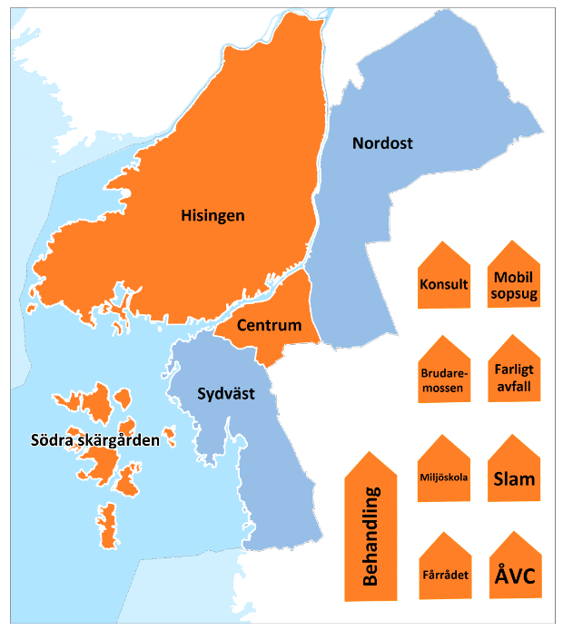
Waste department
The department don’t own any trucks but we do procurements of the collection of waste where we are rather specific when it comes to the trucks.
Fossil-free has been minimum since 2015, mainly achieved through HVO100 and biogas.
(We also has a lot of environmental restrictions when it comes to tyres, motor oil, hydraulic oils, washing and more).
But what about electrification?

Slide 4
It started 2016…
…with a meeting were we asked Volvo Trucks to build there first electric truck as a waste truck made for the City of Gothenburg.
And they said yes.

Slide 5
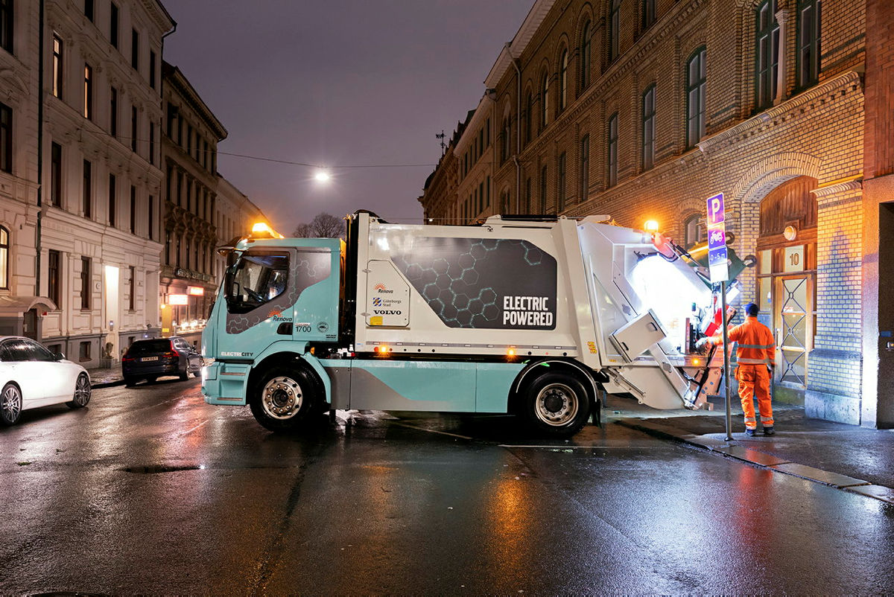
First electric
First electric truck made by Volvo. Presented in 2018 and in ordinary work from 2019.
Photo: Sofia Sabel

Slide 6
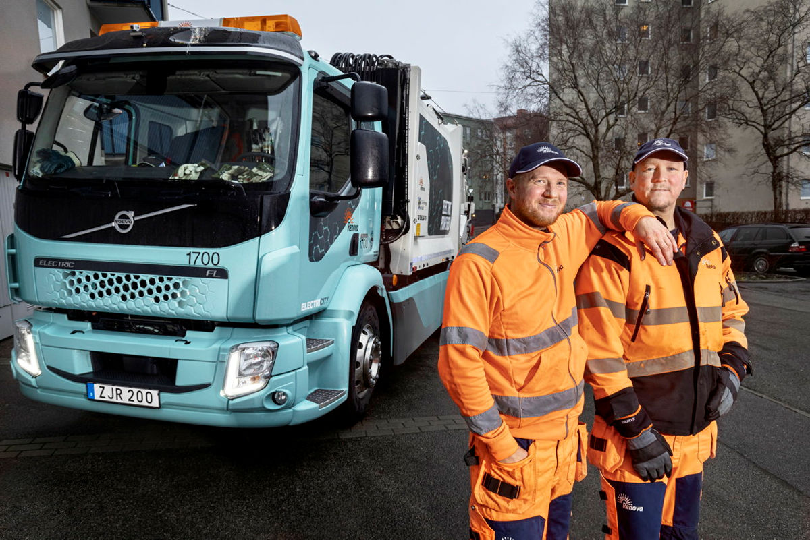
What did we learn?
Analysing and planning is crucial to get the optimal compromise between needed mileage per day and pay load.
To get the right infra structure is not easy…
The drivers loved it
It did the work as we had hoped
Photo: Sofia Sabel

Slide 7
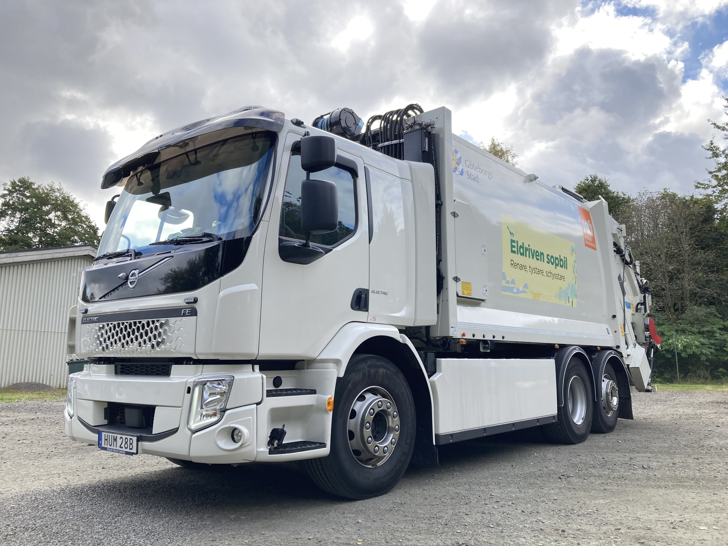
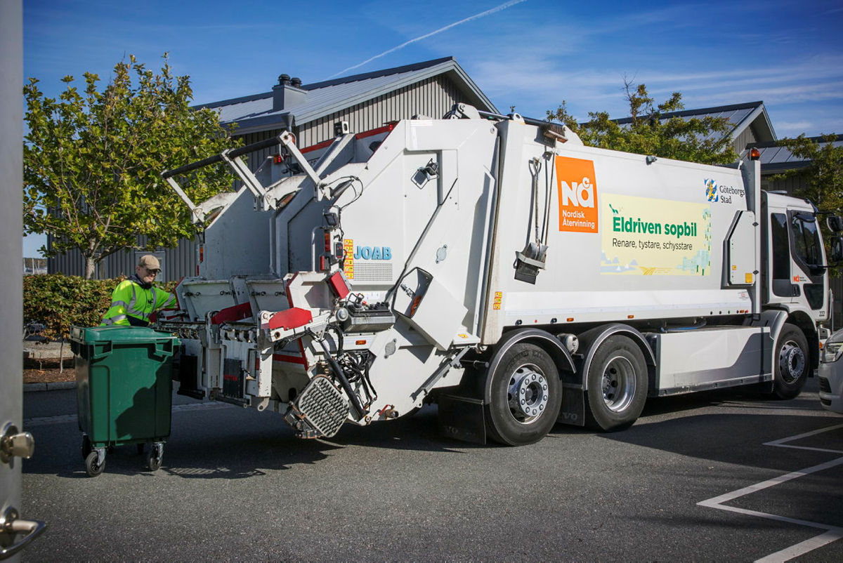
Five electric trucks in a procurment
Before we got the experience from the first electric truck we was crazy enough to demand at least 5 heavy electric trucks in a procurement for the south west part of Gothenburg.
The rest should be biogas.
The contract started 2020
It worked out very well except for some really cold weeks in the winter.

Slide 8
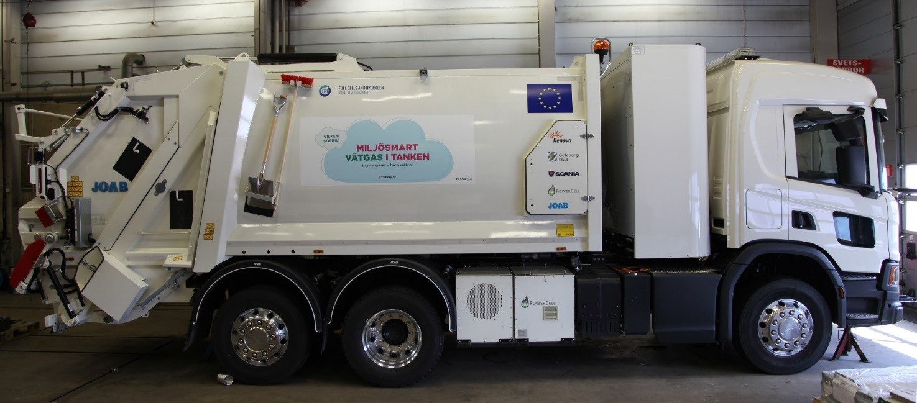
Hydrogen
An alternative when you need more payload, more milage or you don’t have the charging capacity for many batteries.
We had to try that also.
This is a hydrogen waste truck built by Scania and Powercell within a Revive project. It’s a 27 ton rear loader

Slide 9
Electric trucks and charging
City of Gothenburg; second biggest city in Sweden (570 000 inhabitants)
8 battery trucks
1 hydrogen truck
Until recently they have been dependent on one (1) fast charger and one filling station for hydrogen!

Slide 10
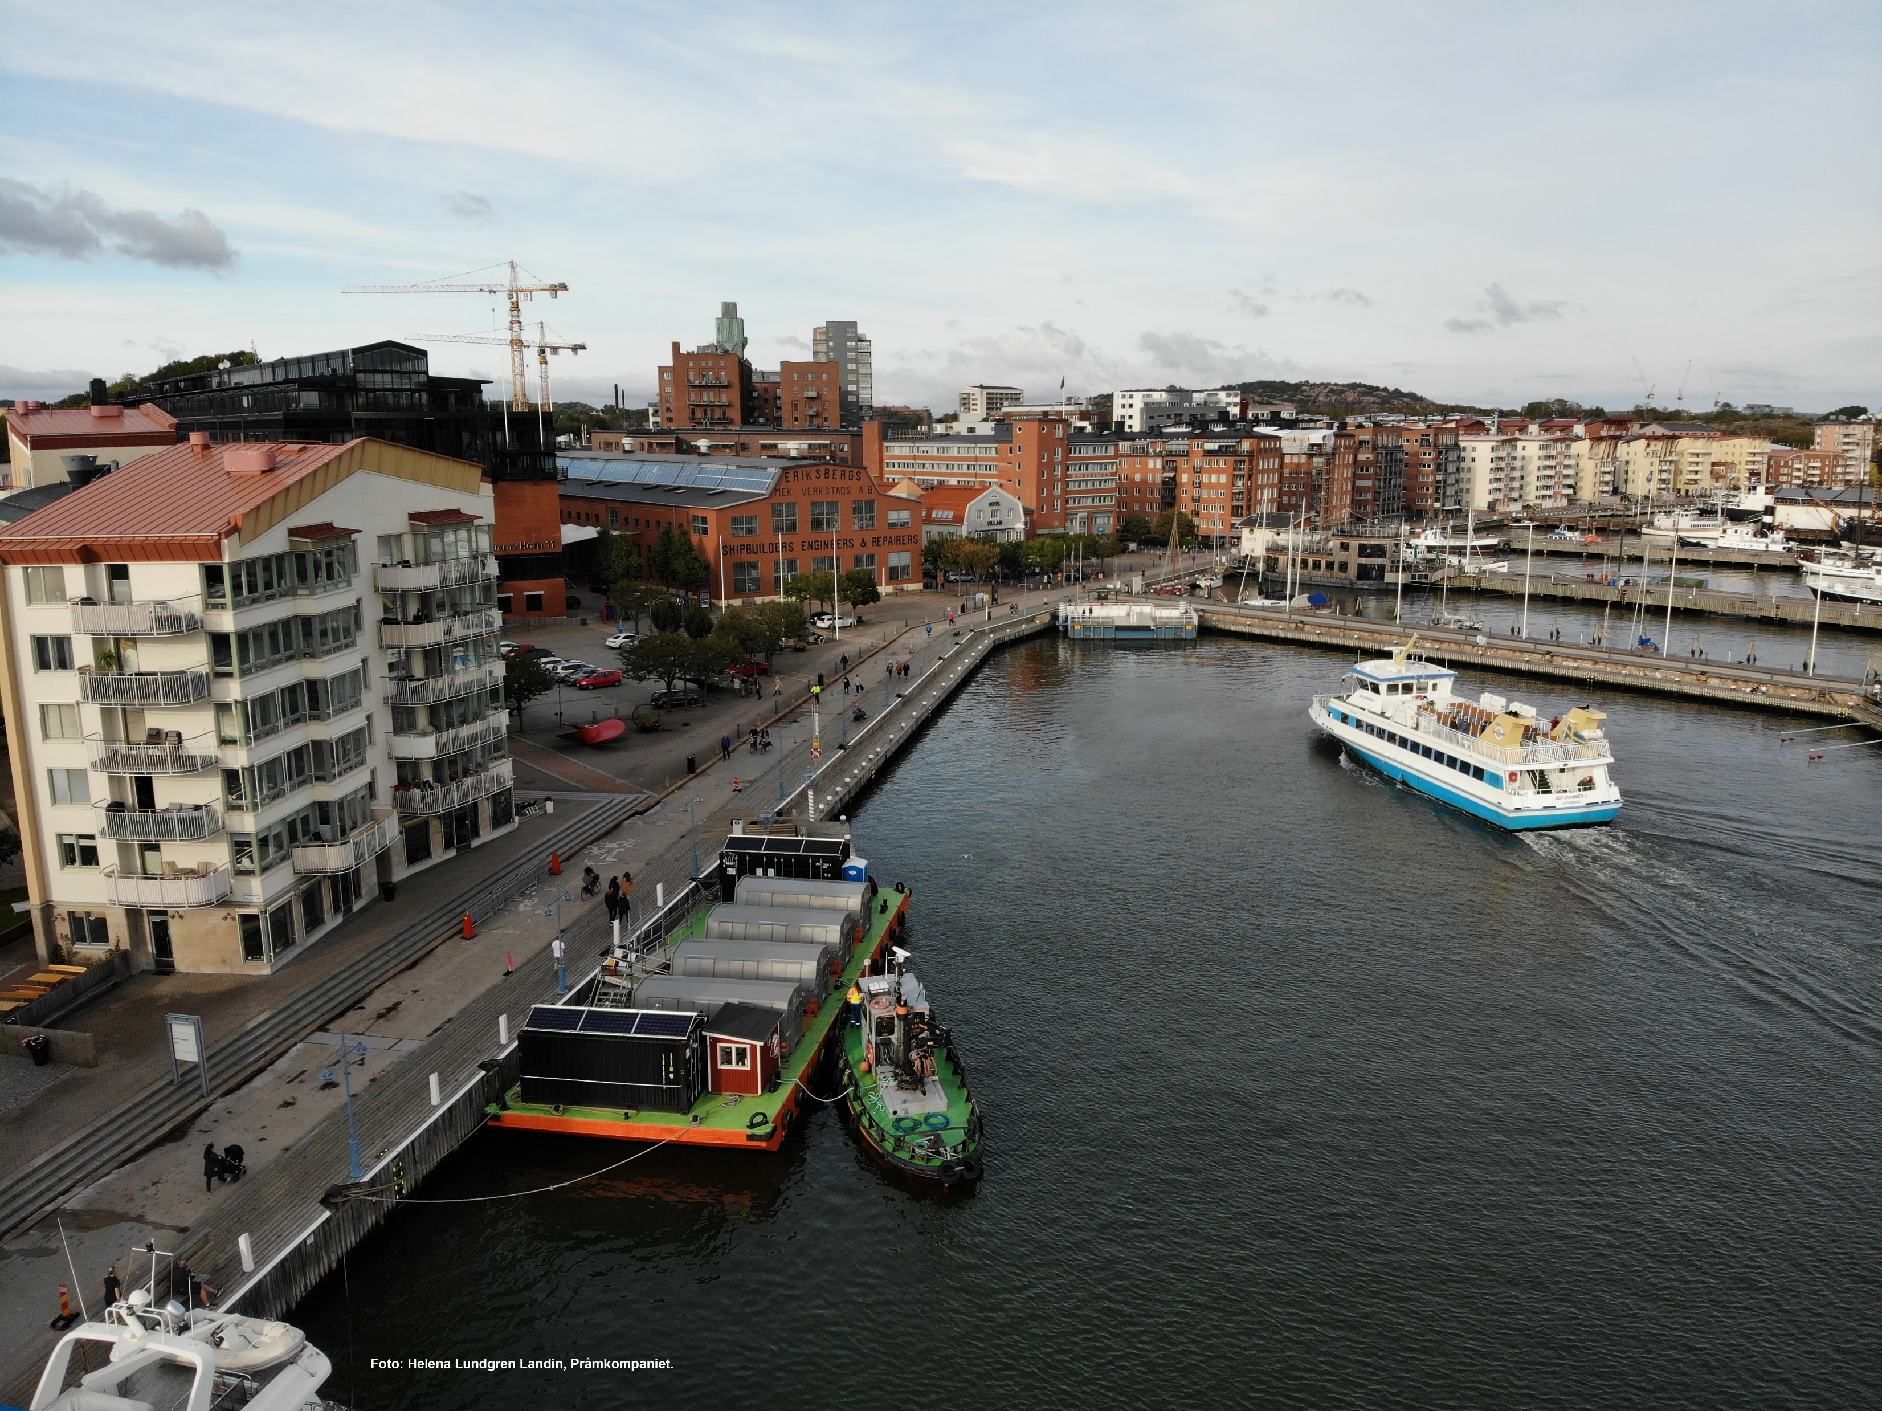
…and more to come
From this spring the tug boat that take care of our floating recycling barge will also be electric.
From next year we will have at least two more hydrogen waste trucks (18 ton) and one hydrogen hooklift.
We are soon preparing next big procurement were the contract will start 2025. There will be at least 15 waste trucks but we are not ready with the special demands yet.

Slide 11
Some conclusions
BATTERY
Less expensive
Better infrastructure (so far)
Better energy efficiency
More analysing before buying
HYDROGEN
Longer range
Short gas-filling time
Better payload

Slide 12
Peter Årnes
City of Gothenburg
Waste department
peter.arnes@kretsloppochvatten.goteborg.se
Thanks for your attention!

Slide 13
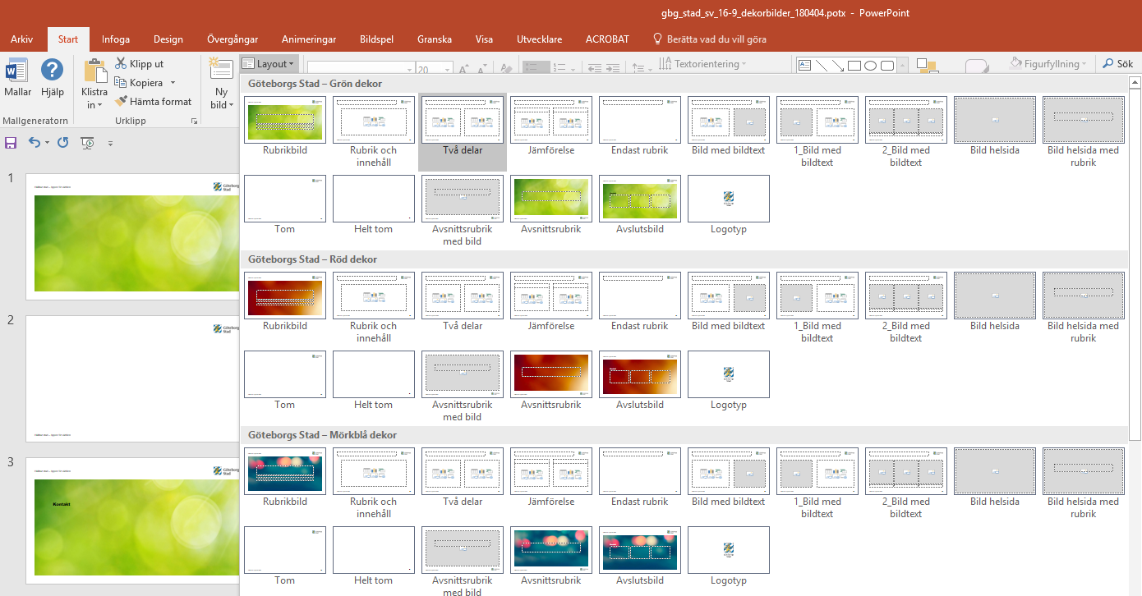
Short instruction
The master templates consists of 8 different templates each witch matching colours
If you want to change template for a slide choose LAYOUT under the START-tab.

