Slide 1
EU Blockchain Pre-Commercial Procurement (PCP) – IPR approach Lieve Bos DG CONNECT F3 unit (“Digital Innovation and Blockchain”)

Slide 2
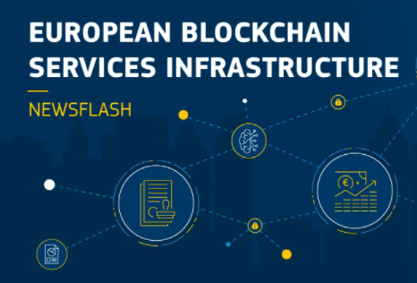
1. What is the PCP about?
EU Blockchain PCP

Slide 3
What is the aim of the EU blockchain PCP?
EBSI = A European blockchain infrastructure to offer cross-border services (e.g. cross-border asylum and migration handling, cross-border certified exchange of university diploma credentials etc.)
More demanding cross-border services (high volume and high velocity) require novel solutions that can deliver better:
Scalability
Energy efficiency
Security
Robustness
EBSI = a cooperation between the EU, EU Member States and some EEA countries
Prepare for future versions of the European Blockchain Services Infrastructure (EBSI)
Contribute to the development of new solutions and standards in Blockchain
Reinforce European position in Blockchain
PCP objectives

Slide 4
Where are we in the process
Phase 1
Solution design
Phase 2A
Prototype development and lab testing
Phase 2B
Final solution development, installation and field testing of limited volumes
Potential Follow up procurements
Deployment of commercial volumes of end-products
Wide diffusion of newly developed solutions
State of the Art Analysis & Open Market Consultation
IOTA
IOV42
IOTA
Supplier ?
DYNE
BILLON
PCP Supplier(s) and/or Supplier X.
Supplier ?
ORANGE
DYNE
Supplier ?
CHROMAWAY
ORANGE
…
BILLON
Minimum 3
contractors
CHROMAWAY
WESTPOLE
Specific contract
Phase 1
Specific contract
Phase 2
Framework contract for the PCP

Slide 5
2. Which IPR approach / techniques were chosen?

Slide 6
Overview of techniques – Across every step of the procurement
Multiple sourcing, phased approach, split from follow-up deployment procurements
Framework contract defined all IPR rights and obligations clearly up front (no negotiation)
A specific selection criterion and evaluation criterion about IPR & commercial viability
Technical requirements
Interoperability and compliance with standards
Compliance with EU regulatory FWs / certifications (e.g. NIS, GDPR) and EU ambitions (e.g. EU green deal target)
Publication and active contribution to standardization by suppliers
Financial offer: Price reduction for procurement of R&D and for follow-up deployment
Admin offer: Declaration of background IPR (updated at every phase)
End of phase deliverables: Assessed also based on realization of commercialisation & IPR plan
Restricted access to the procurement, place of performance conditions, data processing in EEA
Continued implementation / follow-up of IPR obligations after the PCP ends

Slide 7
Overview of techniques – Division of IPR rights
EU Blockchain PCP implements recommendation of EU IPR action plan to leave IPR ownership with contractors, assigning / dividing IPR related rights based on who can / will best exploit them
PCP contractors keep ownership of their IPR (background & foreground)
Comes with responsibility to protect, manage, defend IPR and to commercialise the results / solutions
Comes with strategic autonomy obligations: Obligation to locate the majority of the R&D (during PCP) and the majority of the commercialisation of solutions (including also later after the PCP) in Europe
EC obtains rights securing ‘freedom to operate’:
License free rights (EC + EBSI countries) to use the PCP results, access to background on fair / reasonable terms
Rights to (require) licensing to 3rd parties (e.g. to other contractors working for EC / EBSI countries)
Right to call back IPR ownership in case of non-commercialisation, abusing results against public interest or strategic autonomy / security concerns (e.g. in case of merger with / takeover by non-Europe established / controlled entity)
Right to not forbid the transfer or exclusive licensing of IPR to non-Europe established / controlled entities
With clearly defined consequences
in case of non-compliance

Slide 8
Objectives achieved?
Get rid of supplier / technology lock-in
Open up the market to innovative / small companies
Attract more, higher quality offers
Lower risk & price to buy innovation
Ensure ‘freedom to operate’ for EC and EBSI member countries
Stimulate wide commercialisation
Strengthen EU strategic autonomy & resilience
Min 3 solutions meeting requirements at end of PCP
6 out of 7 contractors are SMEs / startups
35 offers received, enabling many new capabilities
50% price reduction on R&D contracts
Follow-up deployments cheaper: no cost for licenses on results
All rights needed secured
Suppliers asking EC to make this standard IPR approach
Some contractors already secured new business deals
All solutions developed in Europe and
commercialized from Europe
Need to start as early as possible to achieve all that (R&D stage)
Advantage of using PCP: PCP falls outside of international procurement agreements (WTO etc) It was possible to use more advanced / far-reaching measures to reinforce European position

Slide 9
3. How was it really implemented?

Slide 10
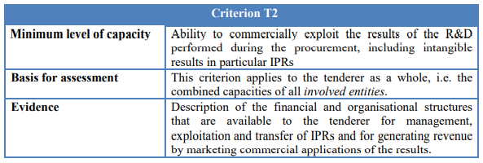
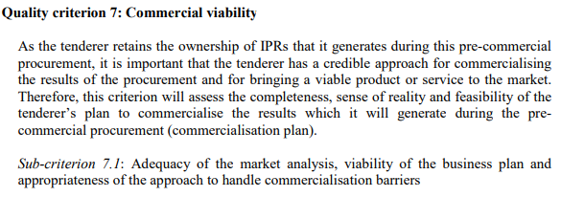
Selection and award criteria
Selection criterion
on technical
and professional
capacity
More info:
See p 50 of TS
Award criterion
on commercial
viability
More info:
See p 56-57
of TS

Slide 11
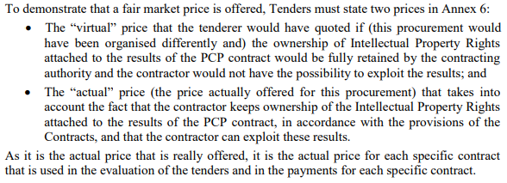
Financial Offer
More info:
See p 61 of TS and
Model financial offer Form
Offer for
the PCP
…
Cheaper price for the
PCP / R&D contracts
More info:
See p 28-38 of FWC
Offer for
procs after
the PCP
Cheaper price for commercial
product in case of follow-up
procurement for deployment

Slide 12
IPR conditions: ownership, protection, rights to use
The contractor retains ownership of all the rights to the results. The CA retains legal ownership of 1 exemplar of the foreground material, incl. source code, design specs, other documentary material. Each party retains rights to its background and gives license to other party to use background after PCP under fair and reasonable conditions (for CA / EBP for its own non-commercial purposes).
S
d
-> For results that are design specifications, this right is unlimited in duration
-> For results that are implementations into simulations, prototypes, products etc, this right is
limited up to 4 years after the end of the FWC, for own non-commercial purposes of EC/EBP…
More info:
See p 28-38 of FWC
Rights to use include
rights to compile and
integrate results into
EBSI and use for 4 years
as part of EBSI + rights to
modify, copy, back-up,
correct errors, translate..

Slide 13
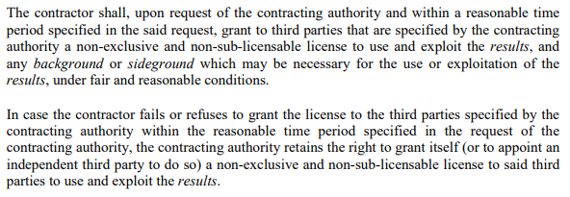
IPR conditions: rights to license + standard commercialisation req
f
f

Slide 14
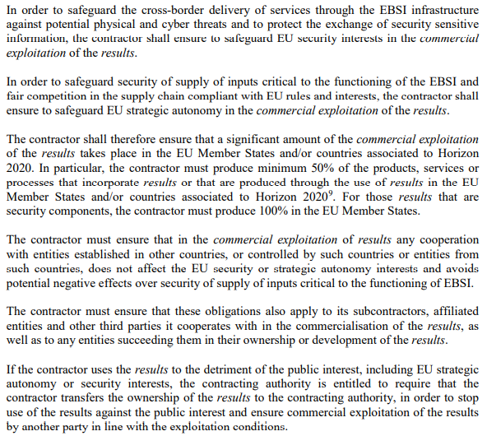
New: EU strategic autonomy – commercialise ‘in EU’ conditions
Here we used EU Member
States & H2020 associated
Countries because the PCP
was funded by H2020.
Otherwise could be limited
to EU Member States.

Slide 15
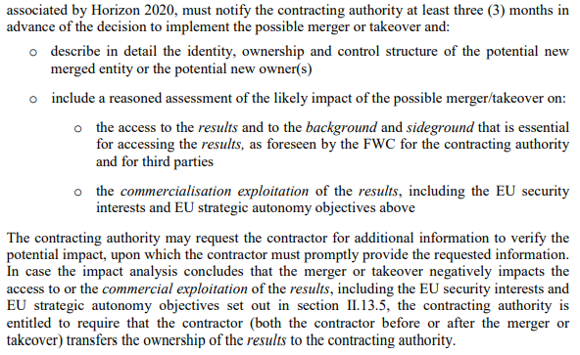
New: EU strategic autonomy - Mergers and Acquisitions conditions

Slide 16
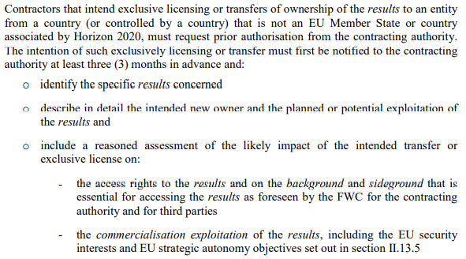
New: EU strategic autonomy – Transfer/excl. licensing of IPR

Slide 17
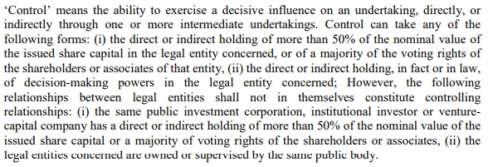
Restricted access to the procurement
WTO GPA and other plurilateral procurement agreements between EU and 3rd countries do not apply to this procurement (it is a PCP type R&D services procurement + it covers security R&D):
We chose EEA because EBSI
is a collaboration between
EU and EEA countries
-> you could restrict this
also to EU Member States only
More info:
See p 40-41 of TS

Slide 18
Restricted access to the procurement
Restriction that country of establishment must be in EEA -> Applies to lead contractor + all members of grouping, but not to subcontractors
Restriction that country of control must be in EEA -> Applies to lead contractor + all members of grouping + all subcontractors
Example:
Switzerland and China is not part of the EEA. Can a Swiss entity or a Chinese entity participate in the procurement?
It cannot submit a tender itself, but could still participate as subcontractor / entity on whose capacity is relied ‘depending on who controls the entity’
The Swiss / Chinese entity cannot submit a tender itself, but it can possibly participate as subcontractor / entity on whose capacity is relied:
Nationals established in Switzerland / China and controlled from Switzerland / China cannot participate in the procurement (not as sole tenderer, nor as member of a group in case of a joint tender, nor as subcontractor, nor as other entity on whose capacity is being relied).
Nationals established in Switzerland / China but controlled from EEA countries can participate in the procurement as subcontractor or as other entity on whose capacity is being relied (but not as sole tenderer, nor as group member in case of a joint tender), “IF” the entity/group that is submitting the tender (sole tenderer or group members in case of a joint tender) is established in and controlled from EEA countries.
Nationals established in EEA countries but controlled from Switzerland / China cannot participate in the procurement (not as sole tenderer, nor as member of a group in case of a joint tender, nor as subcontractor, nor as other entity on whose capacity is being relied).

Slide 19
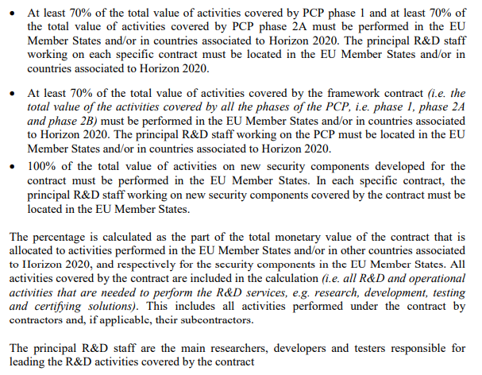
Place of performance conditions
Here we used EU Member
States & H2020 associated
Countries because the PCP
was funded by H2020.
Otherwise could be limited
to EU Member States.
More info:
See p 27 of TS

Slide 20
Place of performance conditions
Technical offer
More info:
See p 51 of TS
Financial offer
More info:
See p 60 of TS
Verification of compliance via end of phase report
More info:
See p 36 of TS

Slide 21
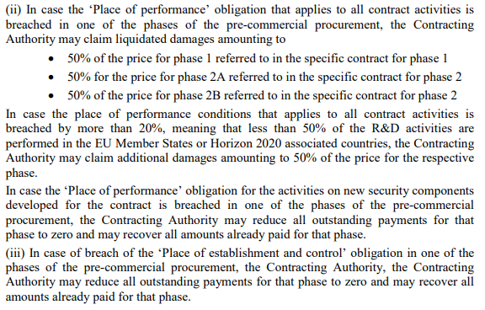
Consequences in case of non-compliance
More info:
See p 14 of FWC

Slide 22
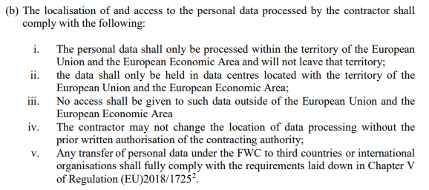
Data processing, storage, access in EU /EEA
More info:
See p 11 of FWC
Here only for personal data, but could be generalized also to other types of sensitive data

Slide 23
Questions? lieve.bos@ec.europa.eu
More info:
Webpage EU blockchain PCP
Tender specs and contracts used for EU blockchain PCP are available online
Economic benefits of leaving IPR ownership with suppliers in public procurement

Slide 24
Evidence of benefits leaving IPR ownership with suppliers
In other parts of the world (e.g. US, Canada, Australia, Japan, Russia, Israel, Korea, China) the default scenario is since decades that the ownership of intellectual property rights linked to all public procurements (not only R&D or innovation procurements) remain with the contractors, unless there are exceptional overriding public interests at stake which require that the IPR ownership is transferred to the public buyer.
There is strong evidence that leaving IPR ownership rights with the contractors instead of transferring it to the public buyer fuels economic growth:
It boosts the growth of innovative companies, including startups and SMEs (adoption of Bay-Dohle IPR act in US stimulated strong economic recovery and growth of startups into giants after financial crisis and the 70s)
It ramps up industrial commercialisation of innovative solutions (5% -> majority of solutions being commercialised)
It reduces the procurement cost for the public sector (~20% price reduction, more for mass volume products)
More info here: https://digital-strategy.ec.europa.eu/en/news/eu-recommends-member-states-leave-ipr-ownership-public-procurements-contractors

Slide 25
Situation in Europe
EU wide benchmarking shows that in most European countries, the legal framework for public procurement is silent about IPR allocation and leaves it to the public buyer to define the allocation of intellectual property rights in its tender documents. As this is not always an easy task for individual buyers, 11 countries in Europe have already adopted a similar national policy on IPR allocation in public procurement as Europe's major trading partners, that leaves the IPR ownership in principle to the contractors: notably BE, ES (via public procurement law), FI, FR, UK and CH (via the general terms for gov contracts), EE, IE, LU, HU, SI (via official guidelines).
This practice is not always followed up by individual public buyers in these eleven countries and that other countries around Europe still lack a clear policy on IPR allocation in public procurement. EU Member States committed in the Startups Nations Standard Declaration that they will adopt an approach to leave IPR ownership with suppliers in public procurements unless there are overriding public interest that require the public sector to acquire IPR ownership.
On 25 Nov 2020, the European Commission adopted a new IPR action plan for Europe to support the EU's recovery and resilience (press release - 25/11/2020) With a view to stimulating innovation and boosting the economy the plan recommends that Member States leave IPR ownership in public procurements with contractors, unless there are overriding public interests at stake or incompatible open licensing strategies in place.

Slide 26
Who are exactly the contractors in the EU blockchain PCP
+
+
+
Phase 2
Phase 1

