Slide 1
Dear participants,
Welcome to the webinar session on the Introduction to Building Information Modelling (BIM) in procurement procedures Please be patient, the webinar will start at 10:30 (CET).

Slide 2
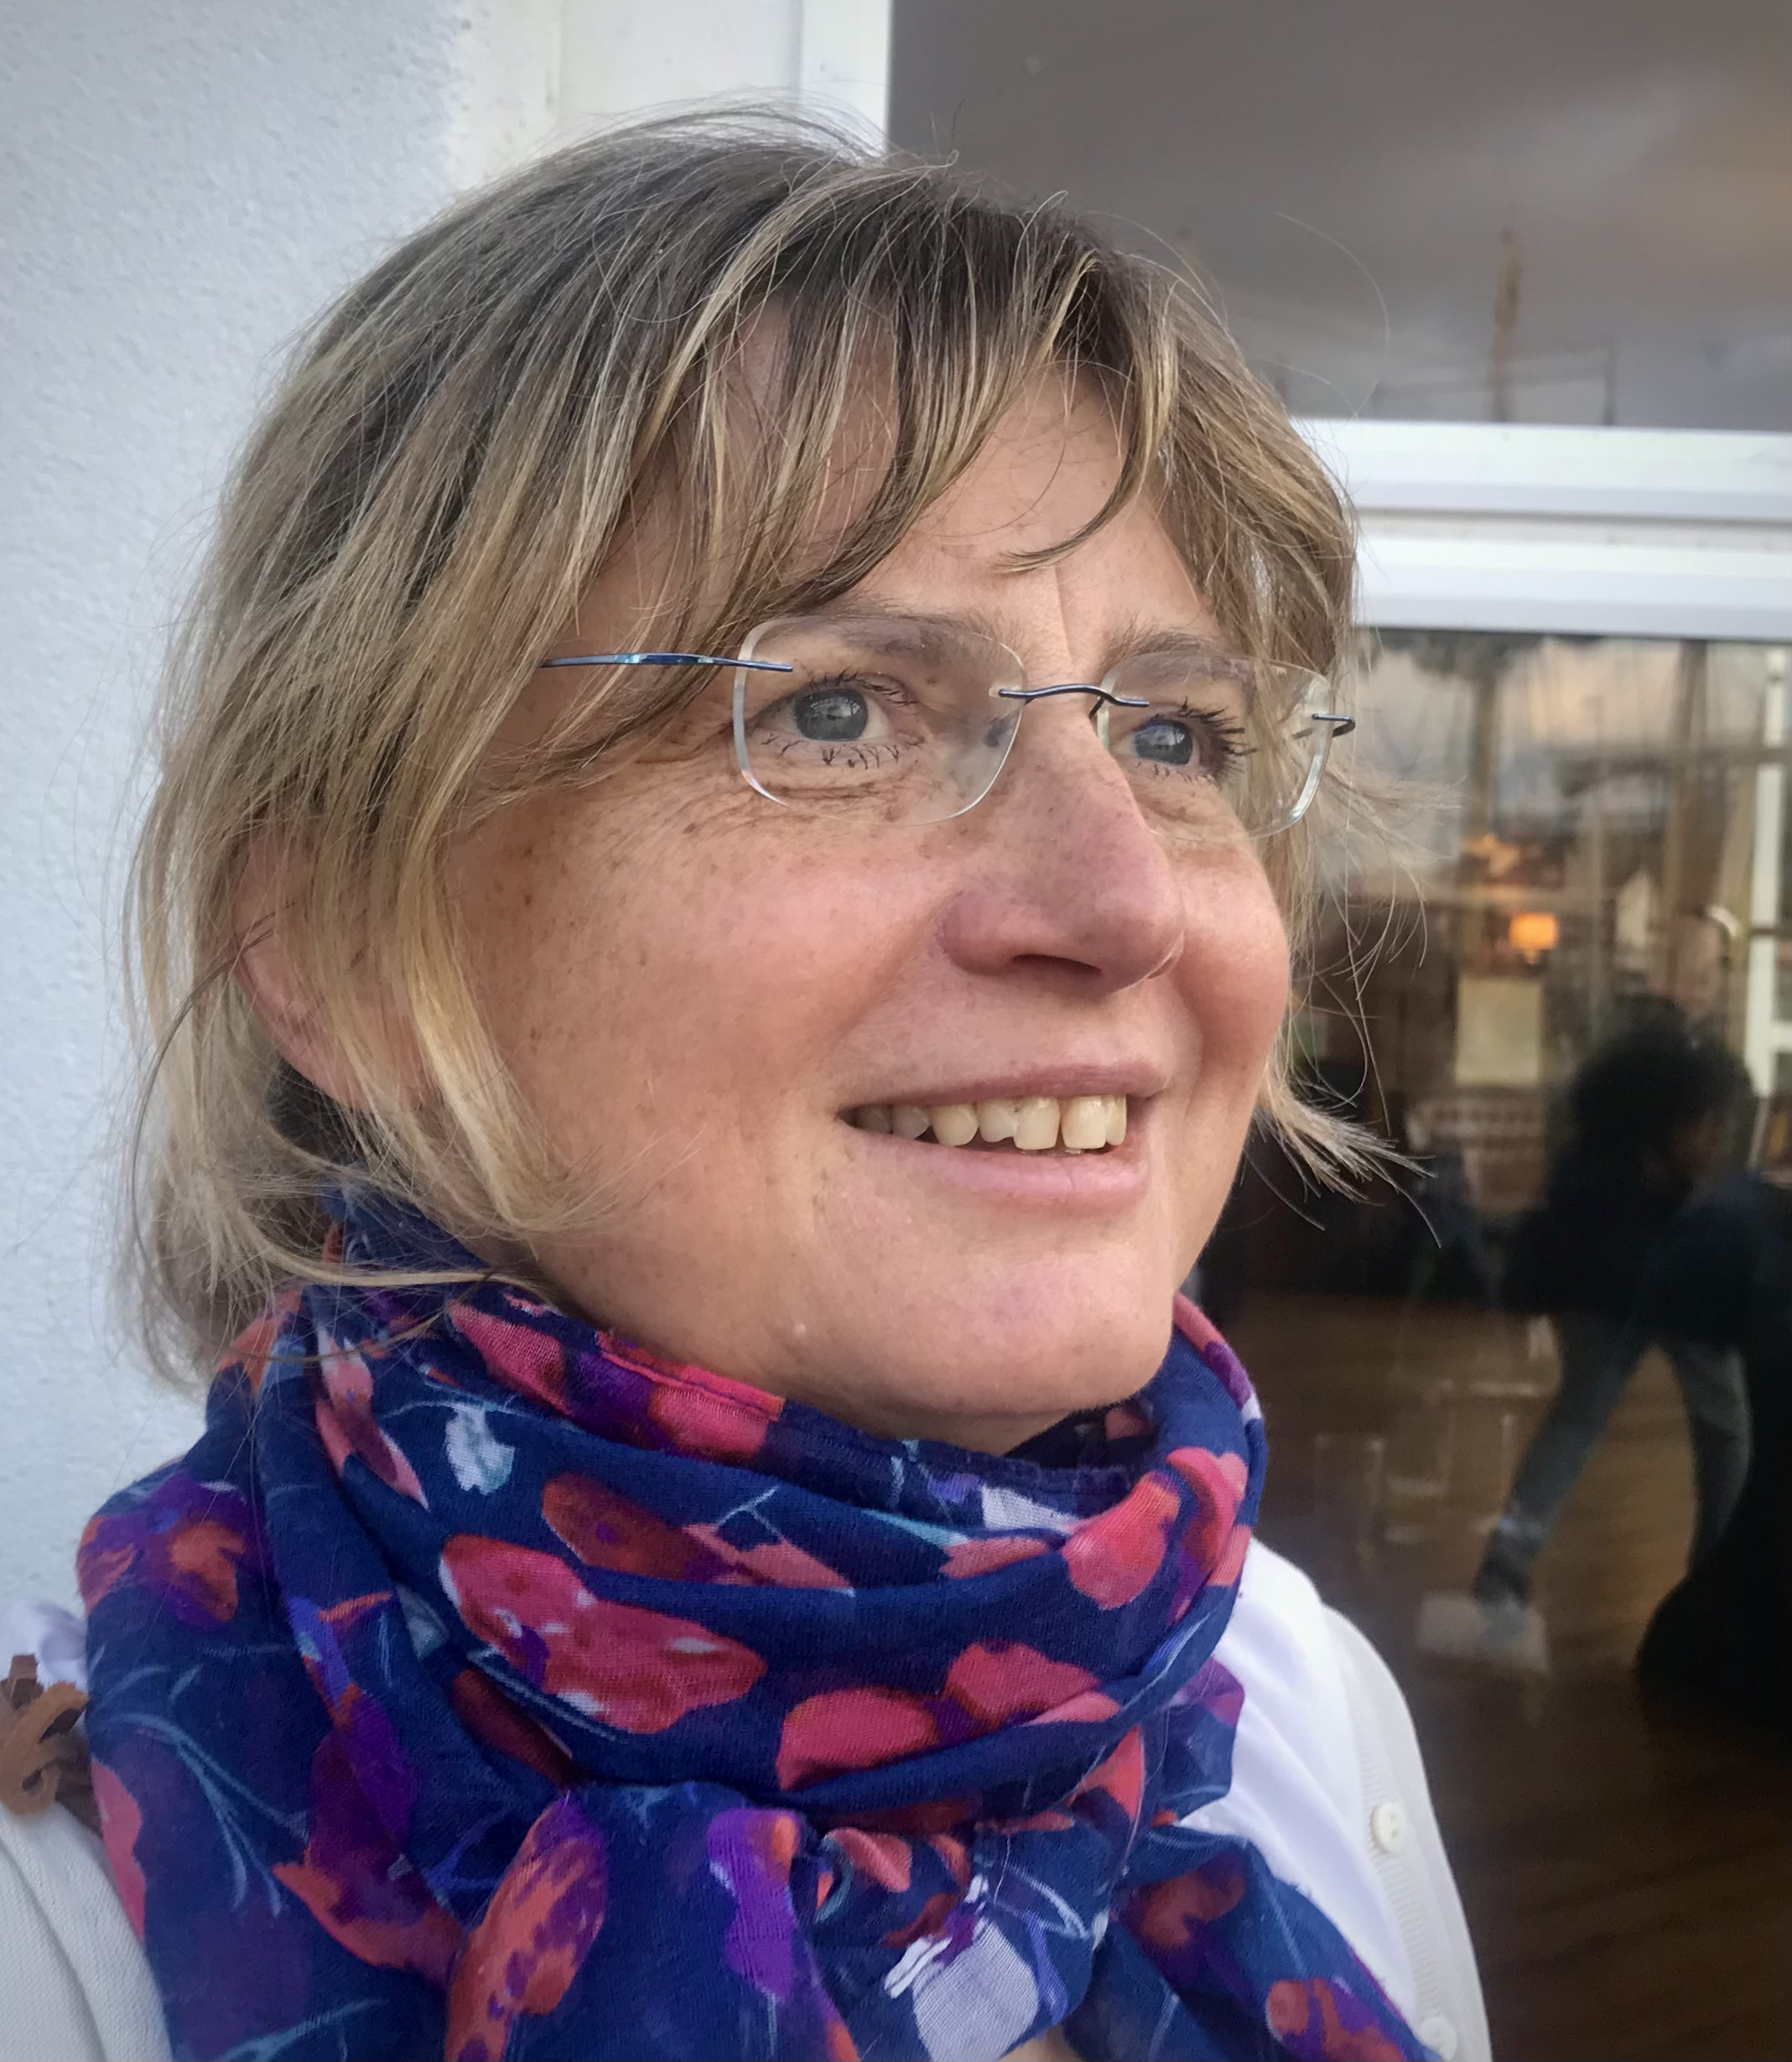
Ivo Locatelli
Senior Expert, Team Leader
DG GROW C2
Public Procurement Policy unit
Marta Toporek
Legal and Policy Officer
DG GROW C2
Public Procurement Policy unit

Slide 3
Webinar objectives
Foster the take up of BIM in public procurement contracts
Get familiar with contracting possibilities in relation to BIM
First step for building the Community of Practice on BIM and PP (Public Procurement)
Today’s meeting is divided into 2 parts:
Live presentations by 3 distinguished speakers
Discussions based on the presentations, on the needs of the PP and BIM and the future activities of the Community of Practice

Slide 4
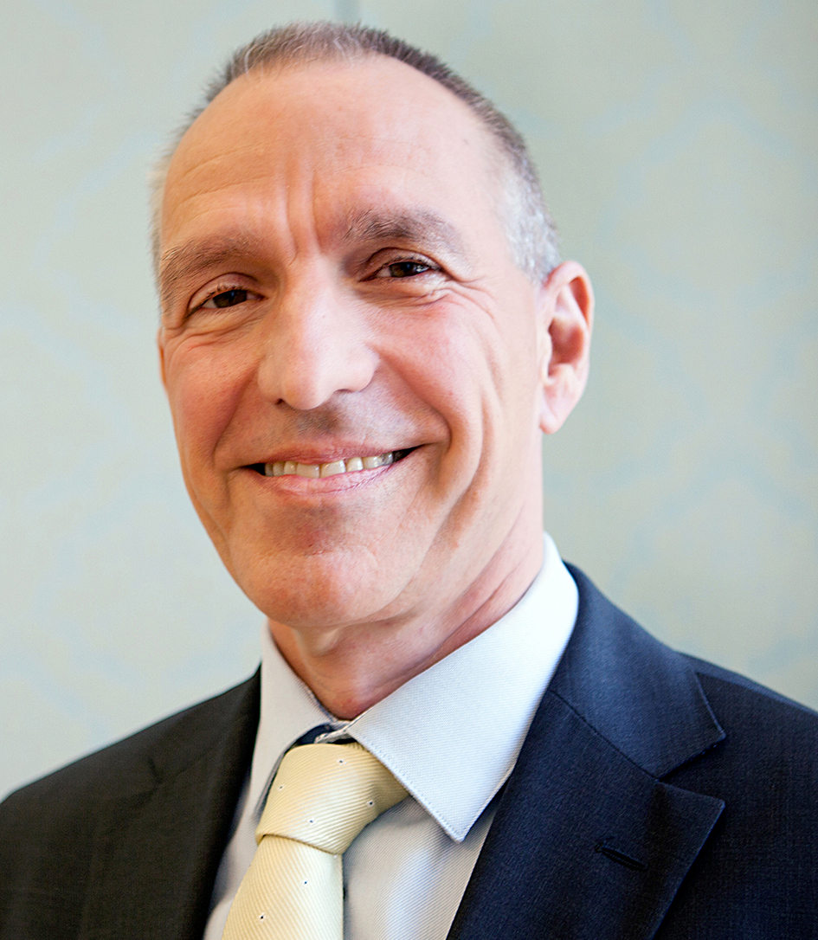
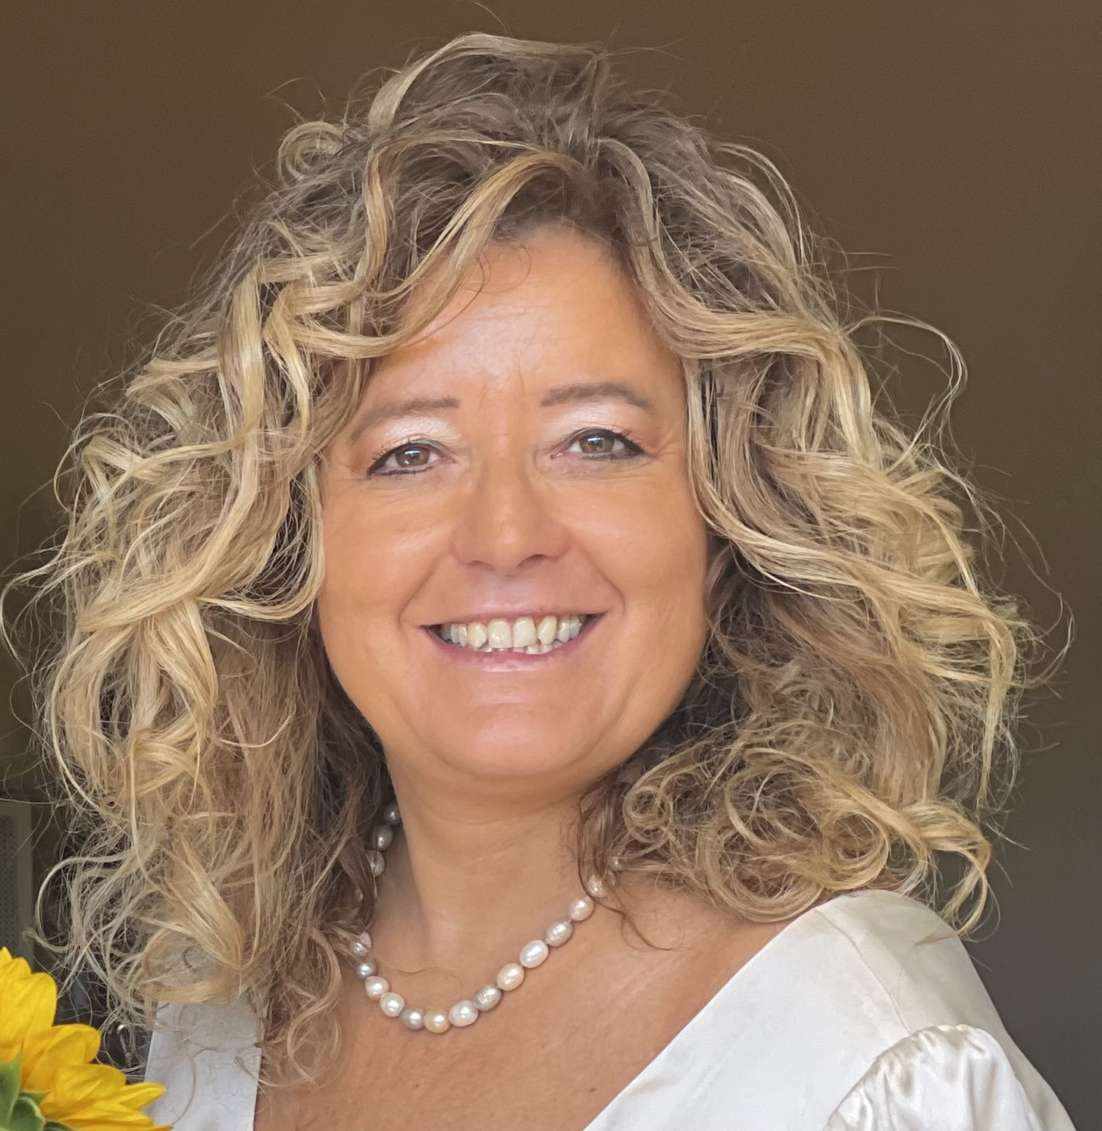
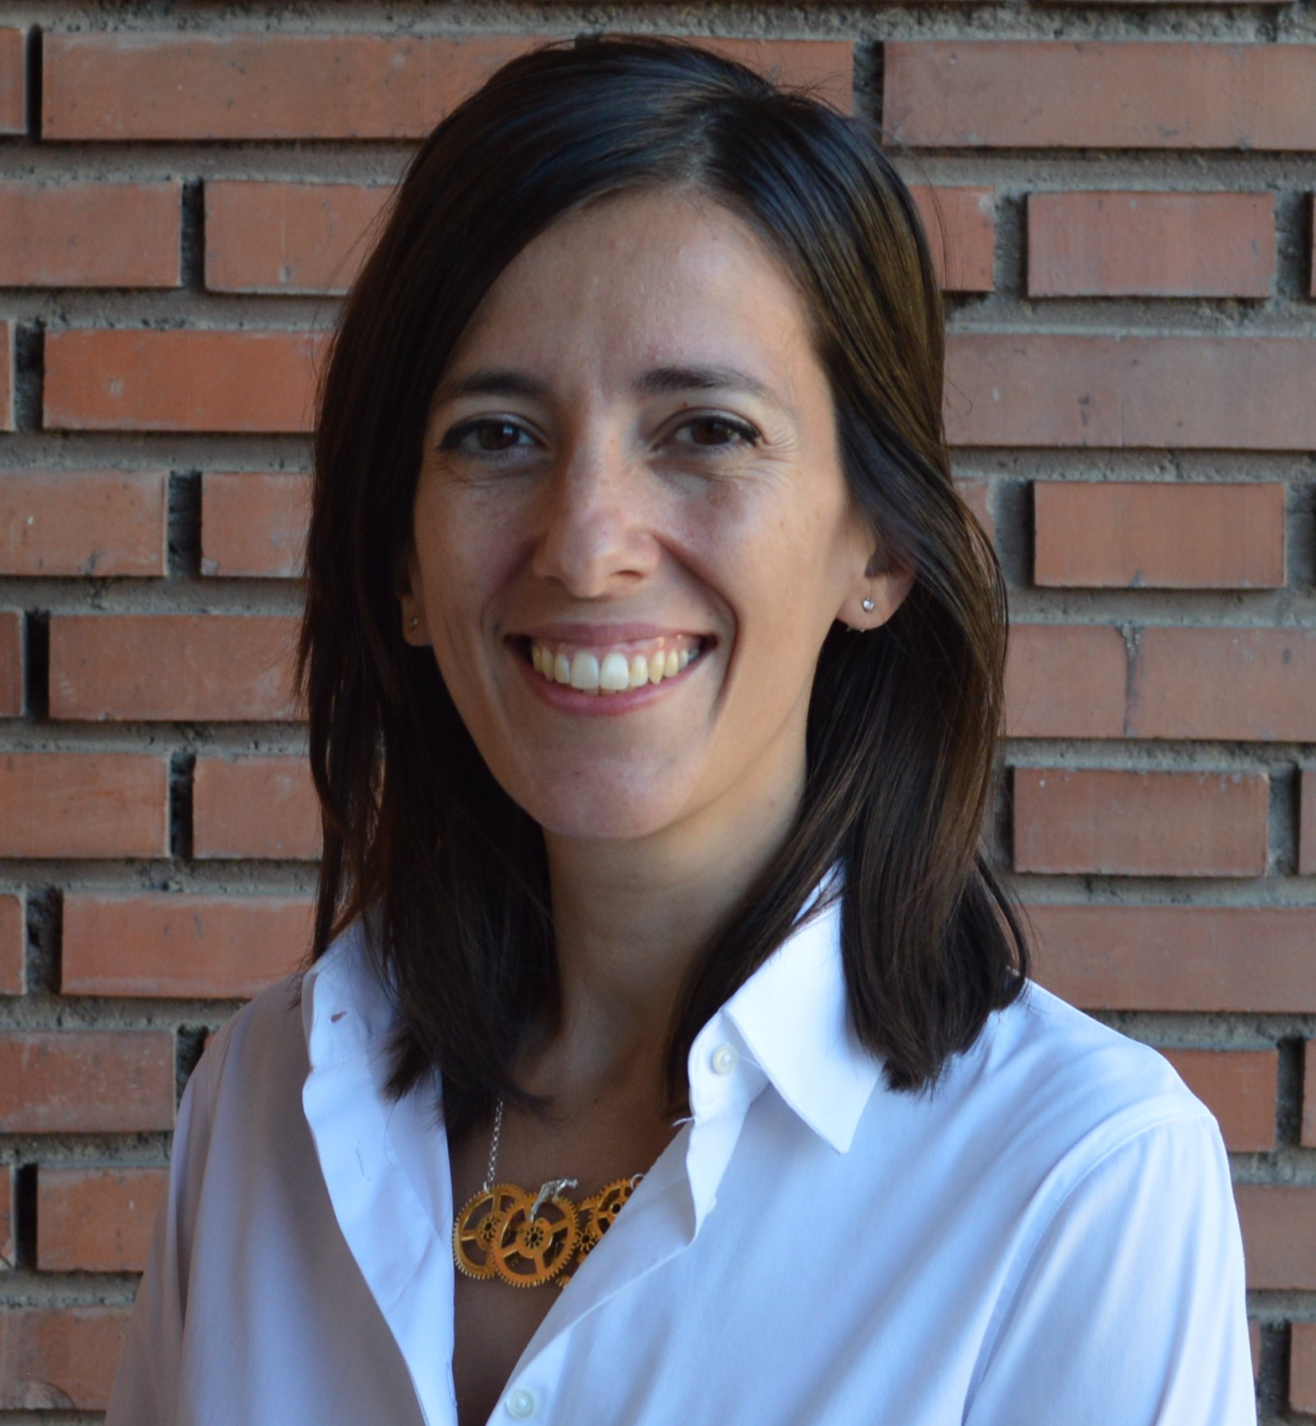
Speakers
Dr. Michael FRUHMANN
Director, Directorate for Public Procurement Law, Austrian Federal Ministry of Justice
Prof. Gabriella Margherita Racca
Full professor of Administrative Law,
Department of Management, University of Turin
Aida Joaquín Acosta
Chief of Cabinet of the Vice minister,
Ministry of Transport and Sustainable Mobility, Spain

Slide 5
What are Communities of Practice?
Browse members’ profiles
Connect through the platform
Exchange knowledge & experiences
Build successful partnerships across the EU!
Identify collaborations
Building on the work of the European Commission’s Big Buyers Initiative, the platform hosts dedicated Communities of Practice (CoPs).
These are specialised groups where members collaborate to boost the effectiveness of public buying in core EU sectors. Communities of Practice reflect current trends as well as ambitions for the future.
Once subscribed to the Public Buyers Community Platform, members can browse the communities and join the one (or more!) that suits their profile and area of expertise.

Slide 6
Current Communities of Practice
Procurement of AI​
Community of Public Buyers for Sustainable Solar PV​
BIM and Public Procurement​
Zero Emission Construction Sites
Circular Construction (CC)
New European Bauhaus (NEB)
Procure Innovation EU
Public procurement dialogues​
Circular and Fair ICT Pact​
Heavy Duty Electric Vehicles
Digital
Social Procurement
Healthcare Efficiency
Mobility
Healthcare Sustainability
Network of Competence Cent​ers
Central Purchasing Bodies (CPB) Network
PPE Alumni Network
Coordination Group Public Buyers Community ​
​

Slide 7
Why join?
Benefit from exclusive access to:
Focused Communities of Practice connecting you with peers across the EU
The latest news directly from the European Commission
A wealth of resources, such as guidelines, brochures, contract templates
EU funded projects & other initiatives on public procurement
Events aimed at public procurement stakeholders
Webinars and training sessions
Public and private discussions on the topics of your interest

Slide 8
European Innovation Procurement Award
20/5/2024
In the category of 'Facing societal challenges: green energy transition', the winner is:
'REGEN3TIQ', submitted by Beam Cube (BEAM³) from France
thanks to design and built with BIM
Innovative digital twin solution reducing:
the energy consumption
the entire lifecycle ecological footprint of public infrastructure and construction works, purchasing, maintenance and management cycle linked to those type of works.
https://eic.ec.europa.eu/news/european-innovation-procurement-awards-winners-announced-belgian-presidency-conference-2024-03-20_en

Slide 9
Thank you!
"BIM and Public Procurement" Community of Practice
BIM and Public Procurement | Public Buyers Community (europa.eu)

